Slide 1
Information Literacy Experiences with AISSMS COE
Vrushali Dandawate
Librarian
AISSMS College of Engineering
Pune
vrushalidandawate@gmail.com
For Presentation in “Information literacy ('Sharing Flemish expertise in Information Literacy training with Southern partners' workshop)” 8-19 Dec 2014 at University of Antwerp, Belgium

Slide 2
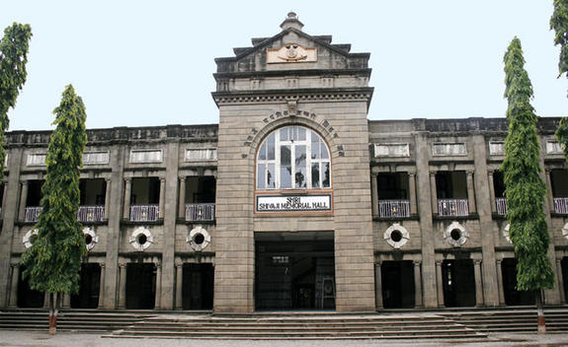

Slide 3
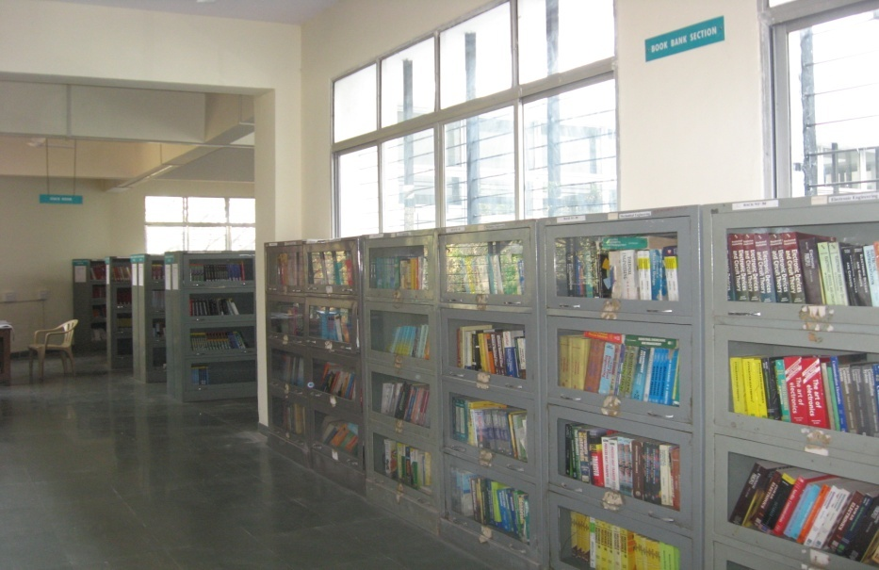
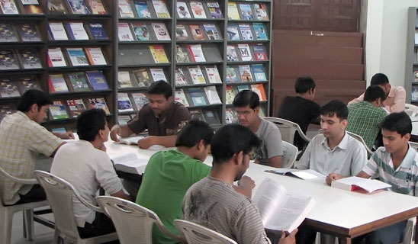
AISSMS COE LIBRARY
The AISSMS College of Engineering Library has acquired a good collection of books and journals in the area of various engineering disciplines. The Library has approximately 31000 volumes of books and 91 national journals. And 612 Online Journals Books are classified according to Dewey Decimal classification scheme. Library is using SLIM 21 (System for Library Information and Management) software. Web OPAC facility is also available in Library. The library is spread over 928 sq.m. area, with an total investment of about RS.2.00 core including all facilities

Slide 4
SUBSCIBED ONLINE JOURNALS DATABASE
SCIENCE DIRECT
IEEE
ASCE
ASME
SPRINGER
J-GATE
MG GRAW HILL
ASTM DIGITAL LIBRARAY

Slide 5
The patrons (researchers and students) informed about and trained in the use of information, including e-resources through Library Website (Created through Open Source)

Slide 6
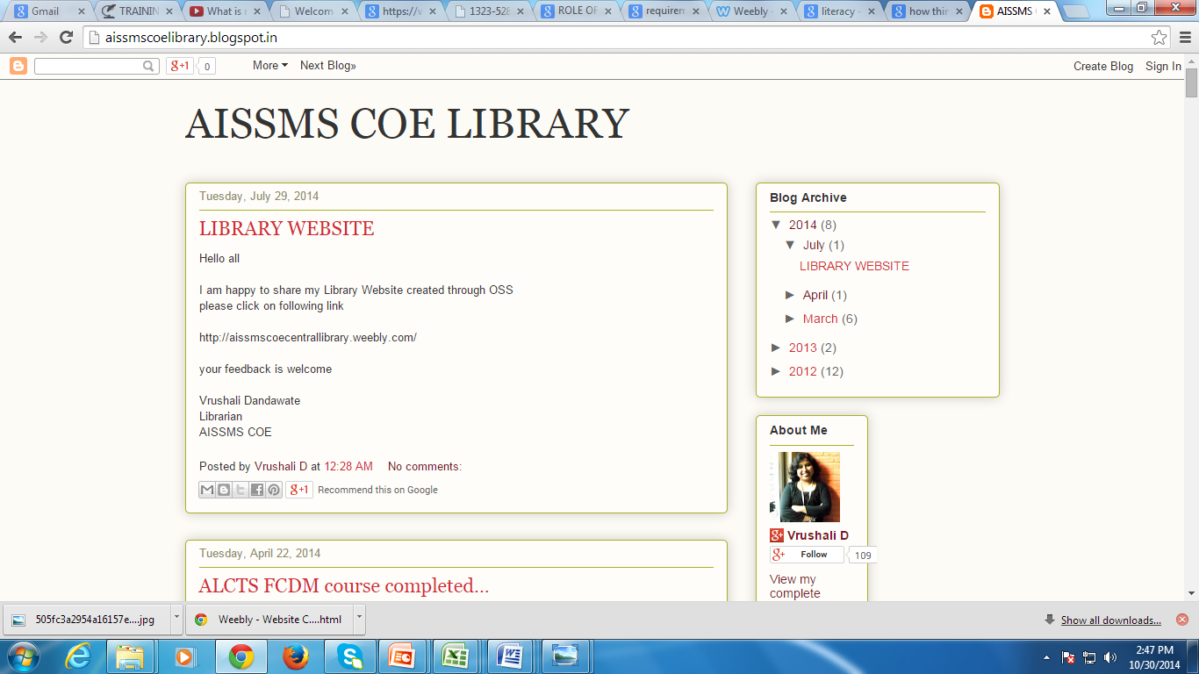
The patrons (researchers and students) informed about and trained in the use of information, including e-resources through Library Blog

Slide 7
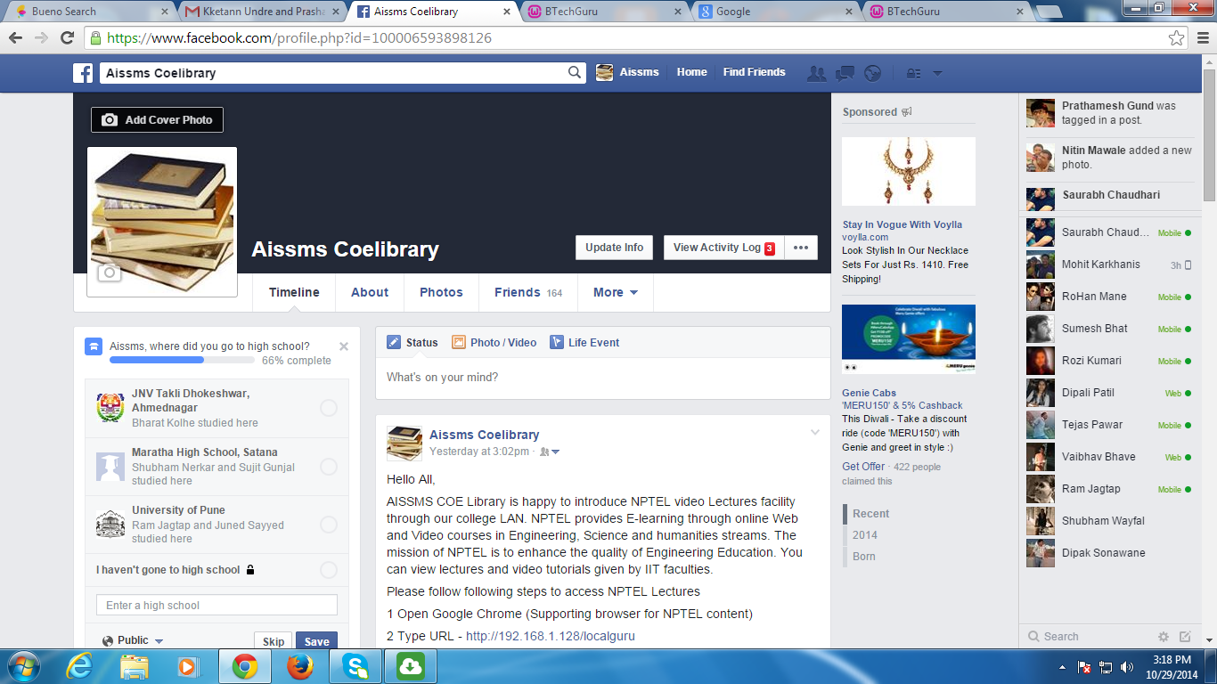
The patrons (researchers and students) informed about and trained in the use of information, including e-resources through social Networking

Slide 9
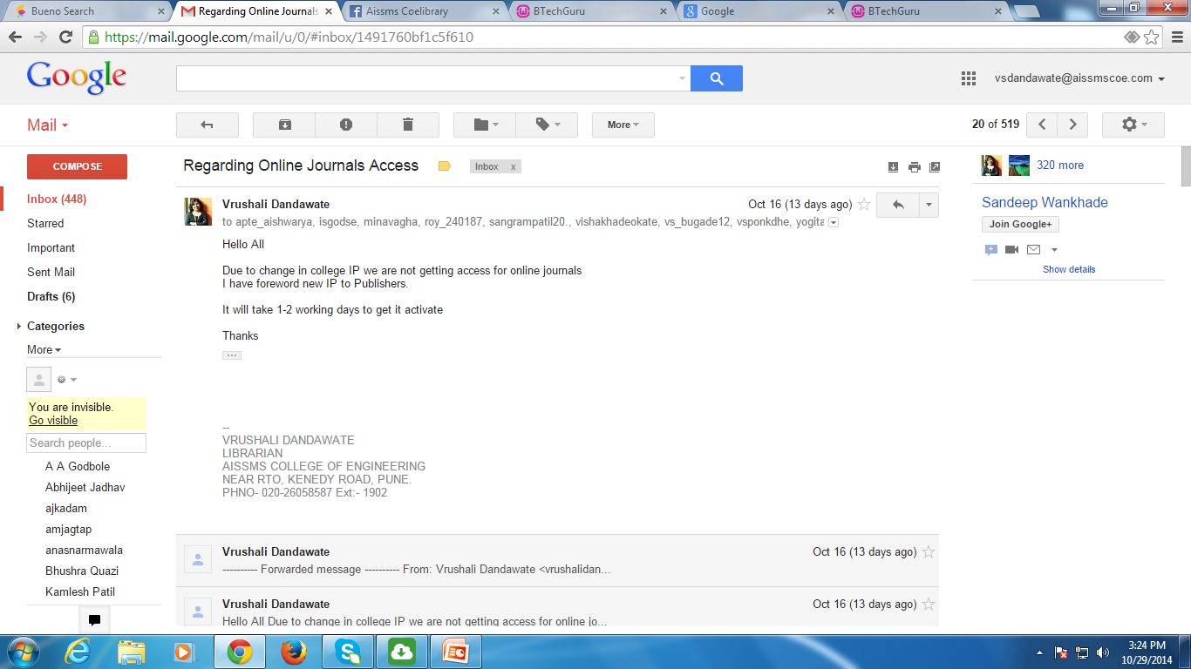
Current Awareness Service With
Email Alerts

Slide 10
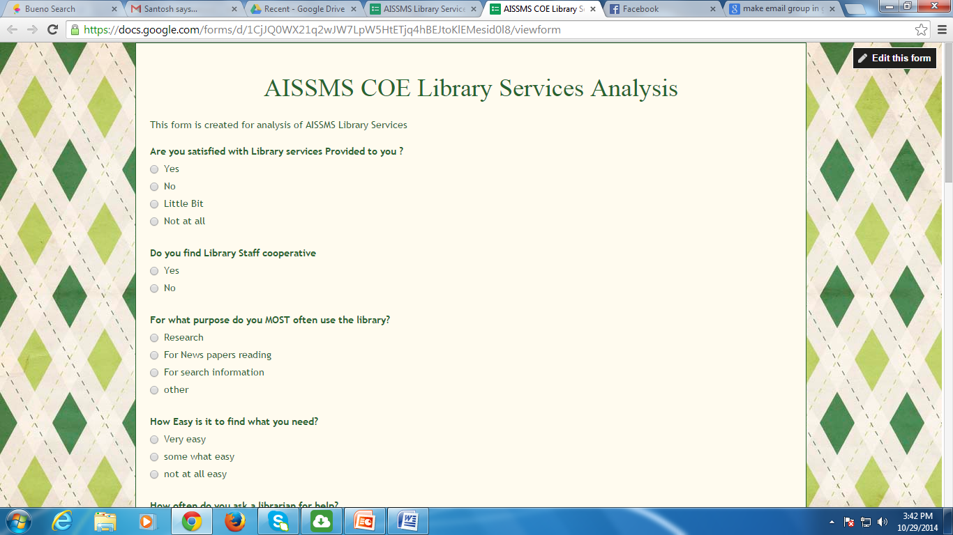
CONDUCTED ONLINE SURVERY WITH STUDENTS AND FACULTY
TO IMPROVE LIBARRY SERVICES

Slide 11
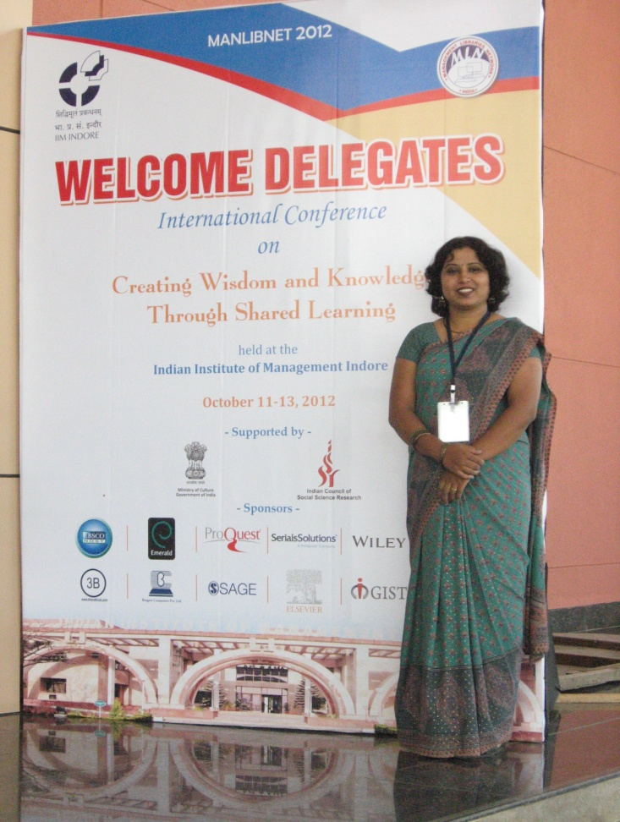
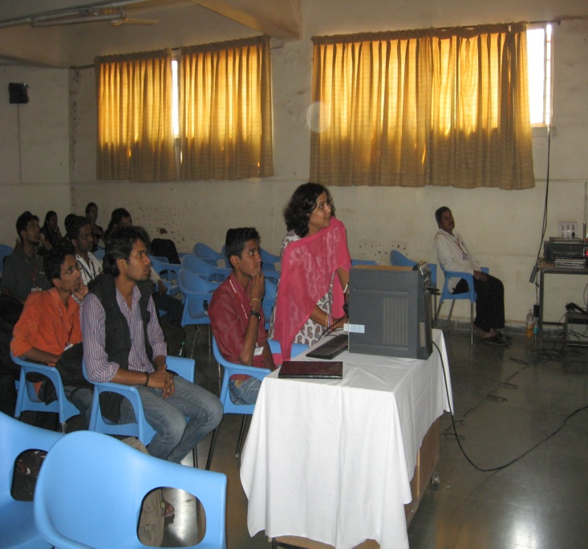
As a librarian how I am informed about and trained in the use of information, including e-resources
By attending some online webinars
By attending some training workshop of different publishers
Through Google search
From publishers websites

Slide 12
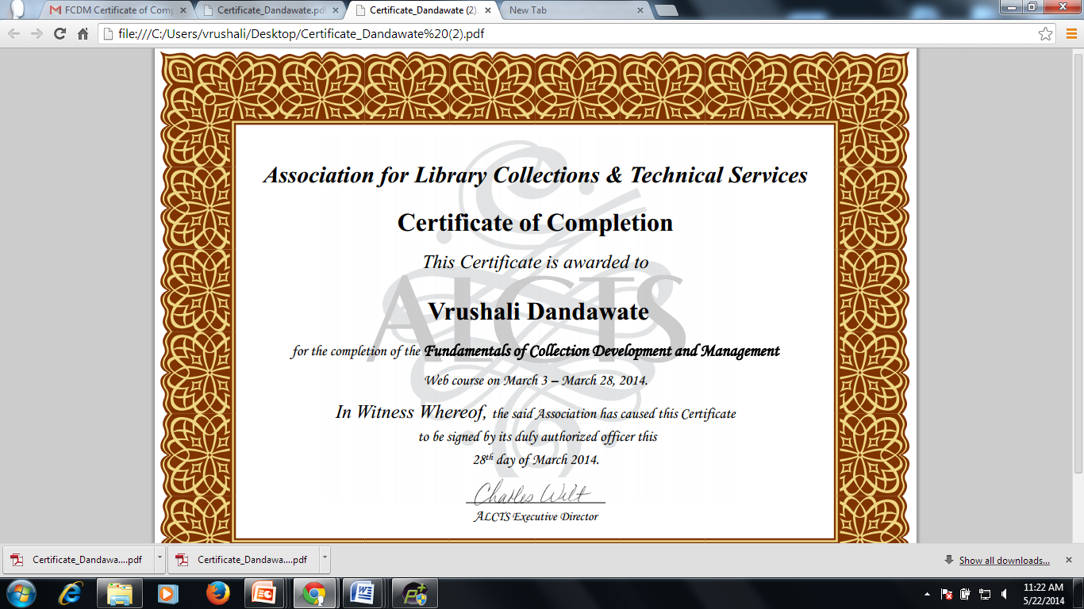

Slide 13
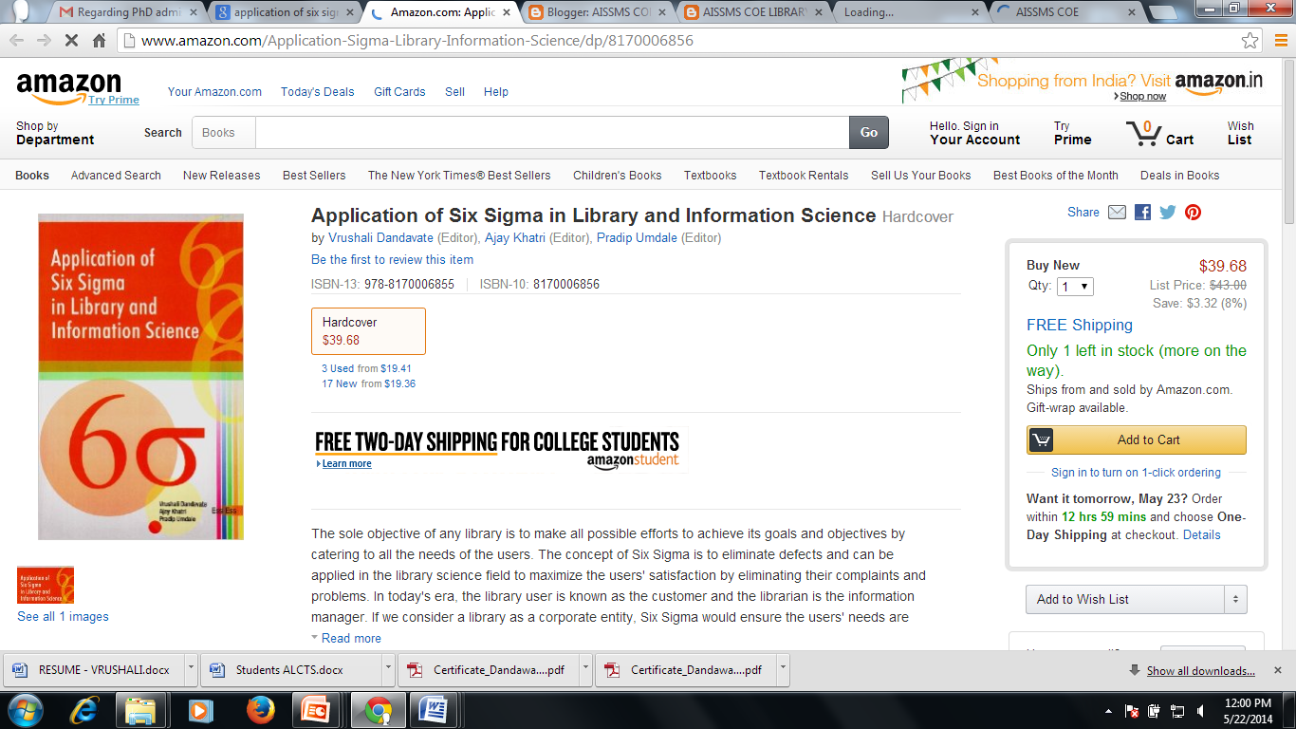

Slide 14
Training to librarians or patrons (researchers and students)
As a Librarian I train to both patrons of my institute and also other Library Professional. I am regularly involved in various activities like Conducting Conferences, Workshops, Book Talks, and Training Programs for Students and Faculty of AISSMS, We are also conducting “Author-Students Meet” events, where students can have live interaction with author of the books.
For other Library Professional we have organized conference and workshop like
Two days National Level Conference on “Impact of Web technologies and E-resources on Library Services, held at AISSMS COE Pune on 27-28 September 2013
National Level Conference on “Application of Six Sigma in Library Science Field” held at AISSMS COE, Pune on 30 September 2012
One day workshop on “Drupal content management System ’’ on 5 October 2012 at Max Bhor Pune

Slide 15
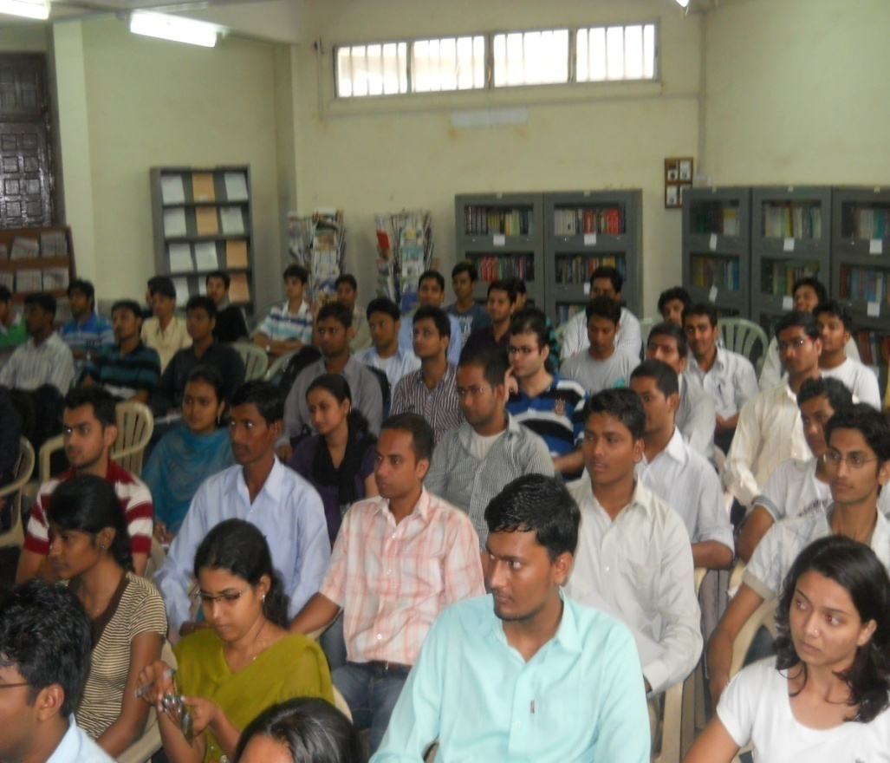
Training Programs were Organized by Library
SCIENCE DIRECT TRAINING PROGRAM

Slide 16
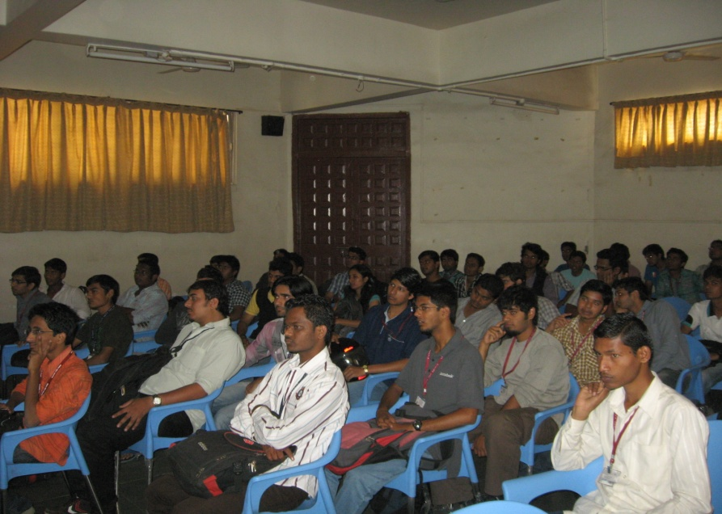
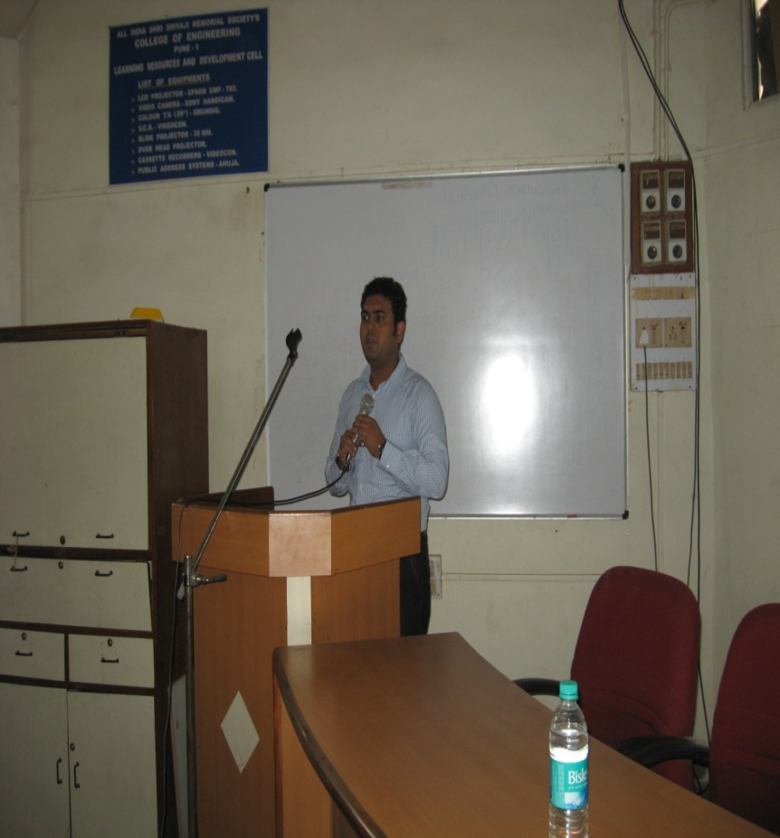
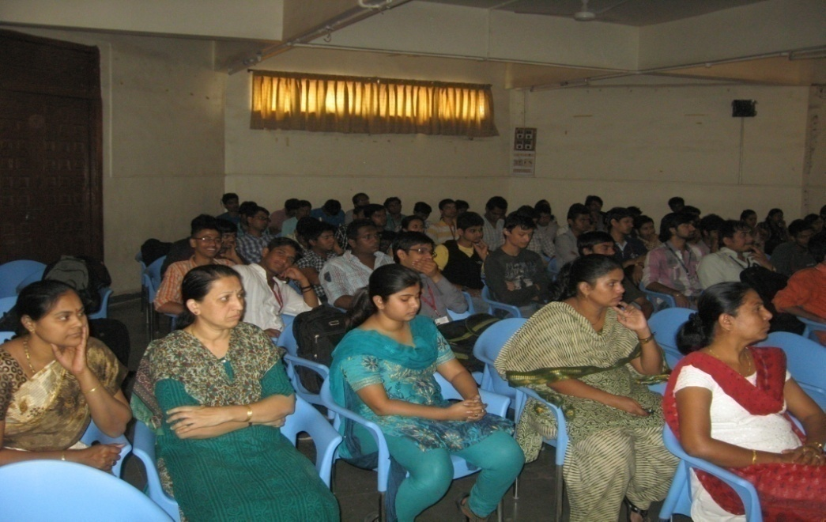
J GATE TRAINING PROGRAM

Slide 17
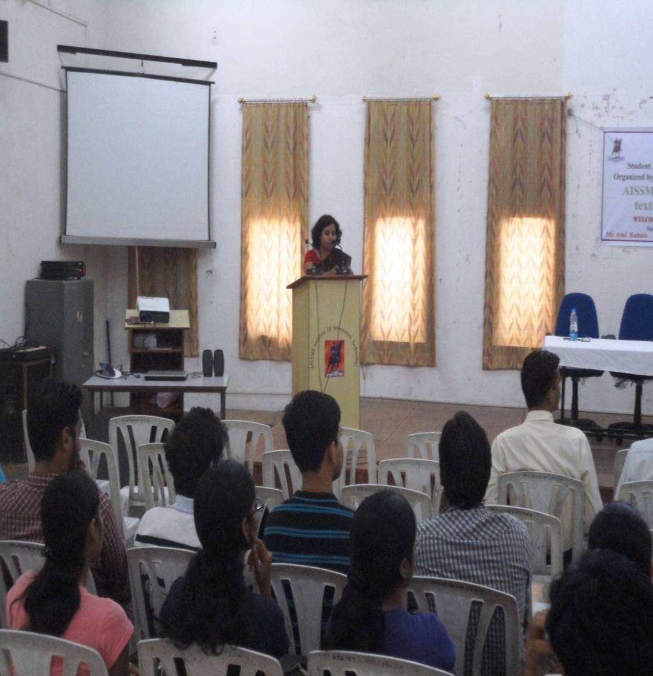
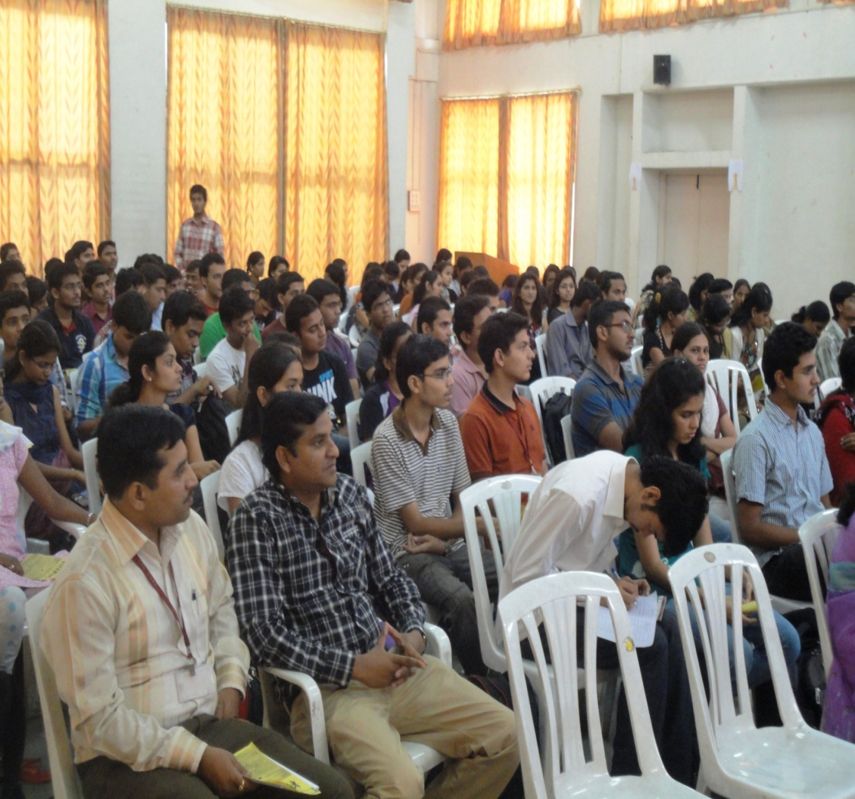
INFORMATION ABOUT SUBSCIBED E-RESOURCES GIVEN in AUTHOR MEET EVENT AND LIBRARY DISPLAY WERE PUT IN COLLEGE ANNUAL SOCIAL EVENTS

Slide 18
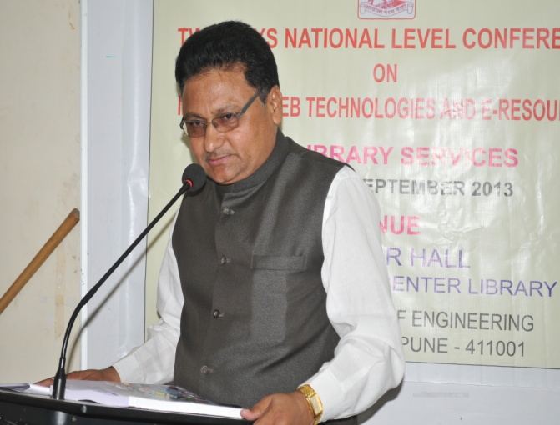
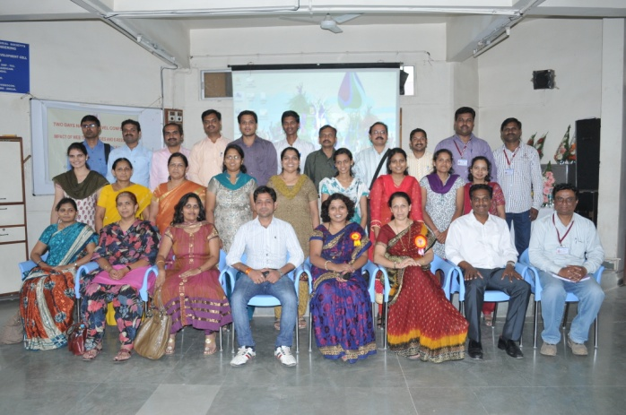
National Level Conference on
“Impact of Web Technologies and E-Resources on Library Services”
27-28 September 2013

Slide 19
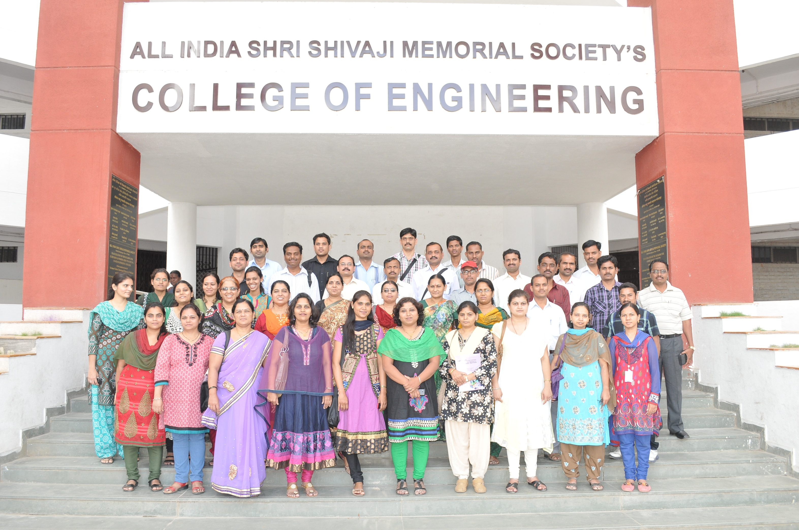

Slide 20
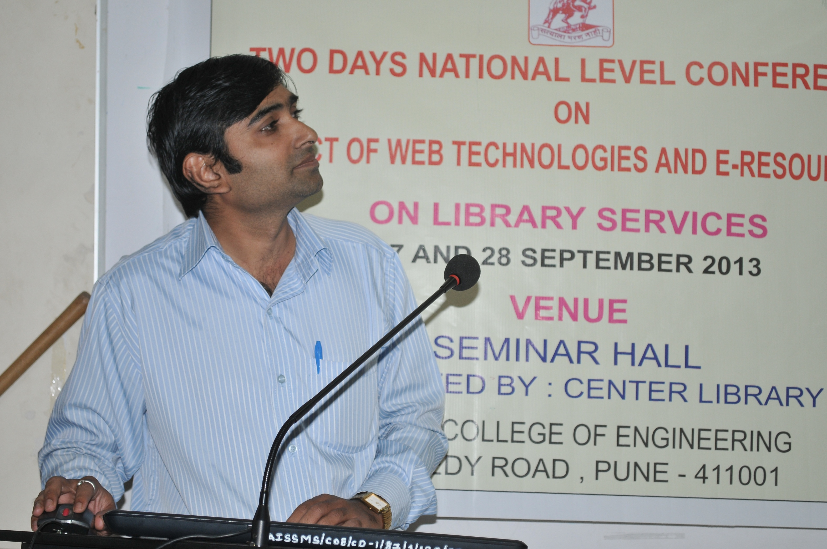

Slide 21
ONE DAY WORKSHOP ON DRUPAL CONTENT MANAGEMENT SOFTWARE FOR LIBRARIANS :
05 October 2012
One day workshop on “ Drupal Content Management Software” was organized by AISSMSCOE, Central Library on 05 october 2012 for Librarians. The main objective of the workshop was to provide participants hands-on on ‘Drupal Content Management Software’ from installation to creating a dynamic Library Websites. The workshop comprises of lectures, demonstration and hands on training using Drupal Software in detail. Sanjay verma (Drupal project manager at Max Bohr Consulting, Pune) was the trainer for this workshop. Total 25 librarians from various colleges from Pune and Mumbai attended this workshop.

Slide 22
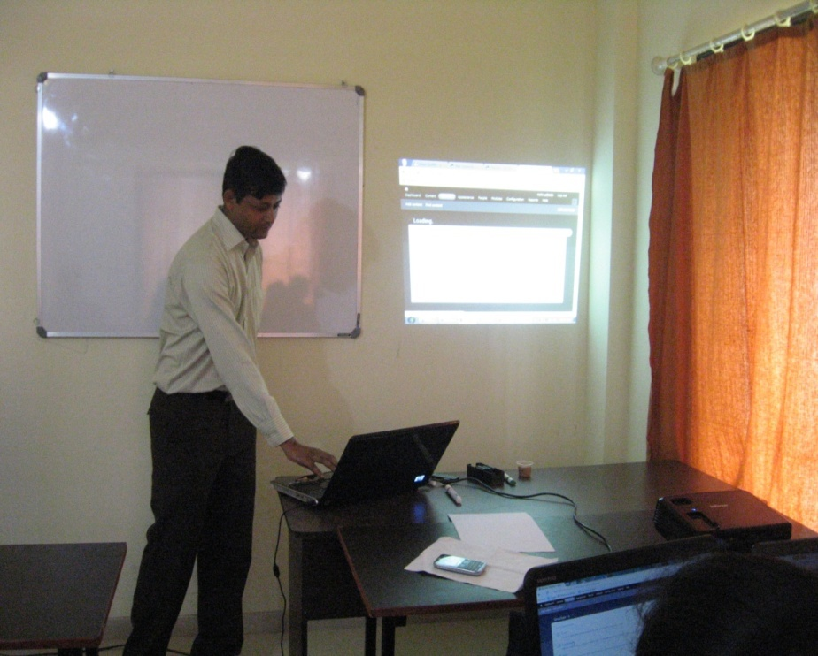
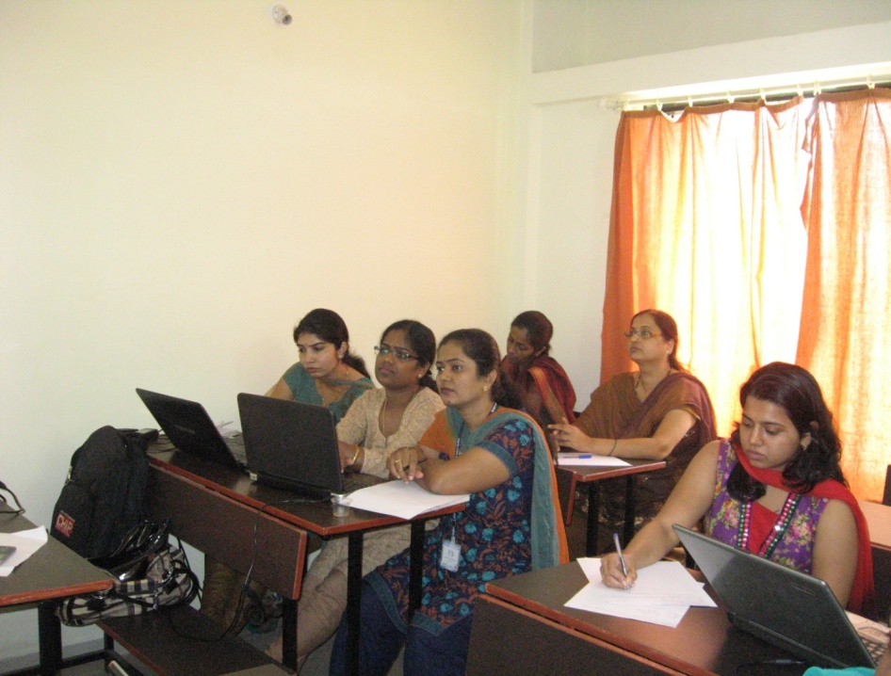

Slide 23
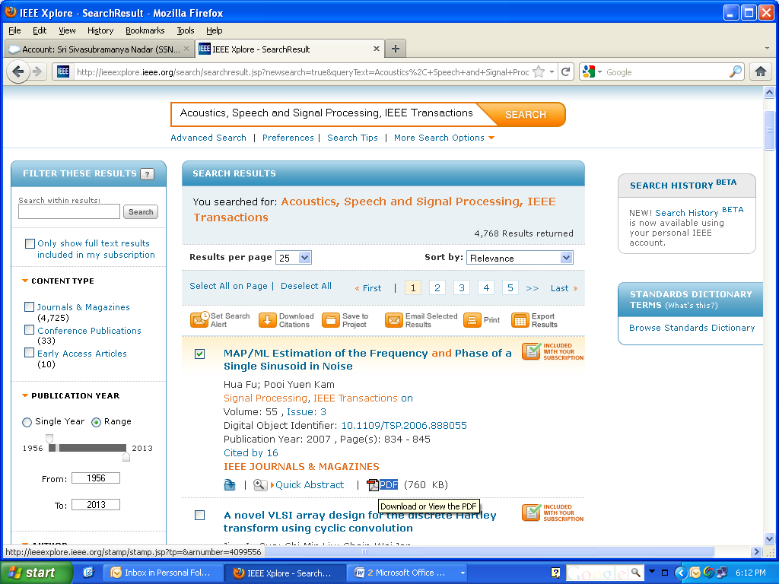

Slide 24
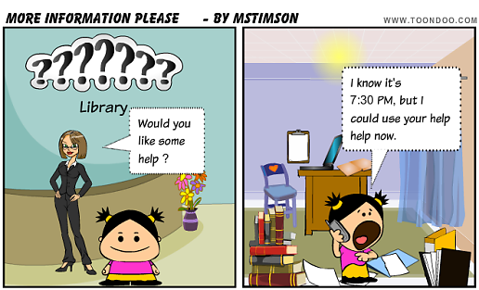
Problems faced by Librarians concerning training in the use of information
Students and faculty are not much interested to attend such programs
Librarians themselves are not interested in such programs
We don’t have much awareness in developing online tutorials and there is no standard guidelines are provided for information literacy workshop
Management role is also less supportive in such programs.

Slide 25
Proposed improvements
Need to develop online or offline video tutorial by Library
Need of more training programs and effort from Library for maximum usage students should get adequate result from database.
Signal search window should made available for all AISSMS COE library Resources

Slide 26
Proposed improvements
Information Literacy tools should be made available on College website
Separate commercial website to be made available for Library Resources
Continuous assessments is required for Information Literacy programs
Need of proper training program on Information Literacy

Slide 27
TO START E-LEARNING CENTER AT AISSMSCOE

