Slide 1
Social aspects of Information literacy:
learning process, experience, users needs, training and barriers of library professionals
MOMENA KHATUN
Vrijwilliger
Department of Information Management
FelixArchief, Antwerp
E-mail: momenakhatun@gmail.com
10 December 2014

Slide 2
What is Information literacy?
Knowledge
Information need
Ability
Location for information
Attitude
Attitudes to new technology
Where to search
Accuracy of information
Use of information
Tools and platforms
Search beyond Google
Search strategies
Appropriateness of information
Communicating
Adaptability with changes
Self learning
Face challenges

Slide 3
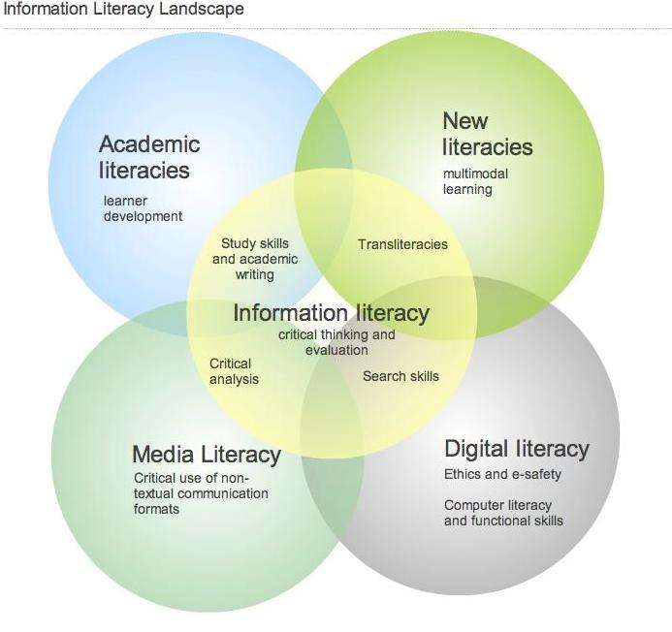
Source: Arcadia Information Literacy Project, 2011, Cambridge University Library, UK.

Slide 4
Key Components of IL Models
ACRL (ALA) | Big6 | Bruce | SCONUL | IFLA | Big Blue project | ANZIIL | CILIP
Determines information need | Defines task | Recognises information need | Recognises information need | Accesses information | Recognises information need | Recognises information need | Understands information need
Accesses information efficiently& effectively | Determines information seeking strategies | Recognises accurate & complete information | Distinguishes information gap is to be addressed | Evaluates information | Retrieves information | Finds information effectively & efficiently | Understands availability of information
Evaluates information critically | Locates & accesses information | Identifies information sources | Constructs search strategies | Organises information | Critically evaluates information | Critically evaluates information seeking | Understands how to find information
Uses information effectively individually | Uses information | Develops successful search strategies | Locates and access information | Uses information | Adapts information | Manages information collected or generated | Understands how to evaluate information
Source : Khatun, M. (2013). Digital Information Literacy of the Oslo Public Library Professionals, Master Thesis, Tallinn University , Estonia.

Slide 5
Key Components of IL Models (contd.)
ACRL (ALA) | Big6 | Bruce | SCONUL | IFLA | Big Blue project | ANZIIL | CILIP
Understands legal, economic & ethical Issues | Synthesises information | Accesses sources of information | Compares & evaluates information | _____ | Organises information | Applies information to new concepts | Understands how to achieve
_____ | Evaluates information & problem solving process | Evaluates information | Organises, applies information | _____ | Communicates information | Acknowledges social & economic issues when using information | Understands ethics & responsibilities in using information
_____ | _____ | Organises information | create new knowledge | _____ | Reviews the information gathering process | _____ | Understands how to communicate findings
_____ | _____ | Interprets information | _____ | _____ | _____ | _____ | Understands how to manage findings

Slide 6
Digital information literacy of the Oslo Public Library Professionals
Research Objectives
To identify the perception of digital information literacy of the Oslo Public Library professionals
To explore what activities are going on for developing digital information literacy
To identify what kind of digital information literacy services are asked by the users
To find out if there is any gap between users’ demands and services available
To recognize the challenges to improve services and prospective solution to overcome these challenges

Slide 7
Location of Research Site

Slide 8
Informants

Slide 9
Number of Informants

Slide 10
Social Aspects of Information Literacy
Learning process
Learning experience
Effective learning
Users’ information need
Experience with the users
Trainings for users
Practical barriers

Slide 11
Learning process
I have received training in the past, now using the internet and different database and also teaching users to use database.
Self-learning
Learning by doing
Sharing knowledge
Participate in Trainings
We also use strategy of helping each other…We can learn a lot from colleague as well just talking to each other helping each other.
We try to learn how to use the databases in our work… We learn it along all the way. So, it is not like we sit down and today we are going to learn.
I take initiative and try to find out things and doing things, try by myself instead of waiting for someone to do it.

Slide 12
Learning experience
Time consuming
Difficult
Stressful
Easy, exciting
and fun
It can be actually difficult, easy or time consuming altogether…mostly it is easy because we go step by step…
It was stressful …we were thrown into using the search engine and you want to provide a good service for the customers
Difficult, when we learn something new you also have to build on that information, we have to use it in practice a lot.
It is time consuming. I do not think I have enough time to learn all the things.

Slide 13
Effective learning
Formal course and
Practice
In-house training
Helping each other
To be able to help the staff each other on daily basis is may be the most effective way as a lot of very specific things happens every day…
Taking that information and learning and teaching others here at the branch
It should be formal training because … there are probably fields that I do not know and there should have someone to introduce to me.

Slide 14
Users’ information need
General information need
Query about particular government laws
Stamps on paper for notarization
How to book a hotels, tickets
How to fill a job applications
Filling up visa forms
Reading online newspaper
Internet banking & Bill payment Searching for accommodation
Tax file submission

Slide 15
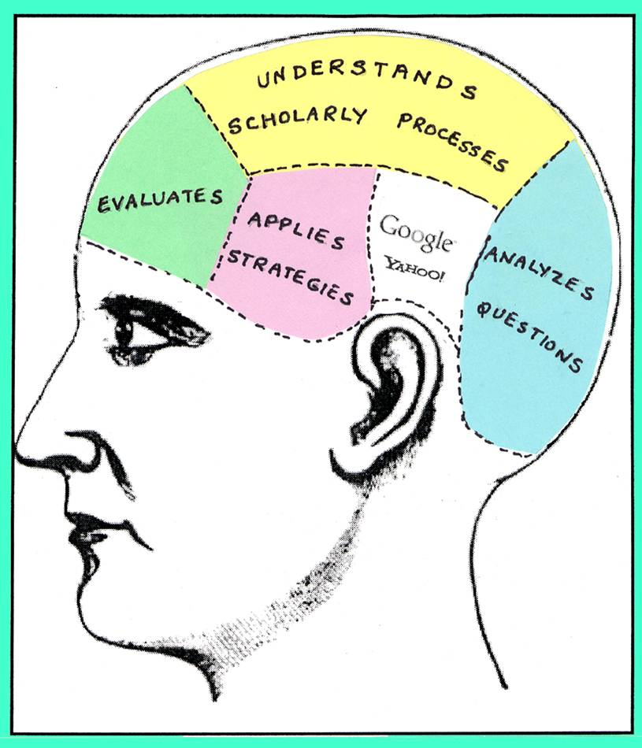
Users’ information need (contd.)
Academic information
Topic for course project or research Searching information
Where to search
Proper wording
Google or google scholar or data base
Critically evaluate information
Authenticity of Information
Which information sources should be used

Slide 16
Users’ information need (contd.)
Synthesize the information
Use the information
Create new knowledge
Ethical use of information
Need for prior permission
Citation
Where to publish
Journal evaluation

Slide 17
Experience with users
Different level of request
Different users group (Layman to Researcher)
Users’ need Users’ competency level Users’ social and educational background Exposure to technology Users age (generation X & Y)
Training for users One to one Group based
Program based
Need based

Slide 18
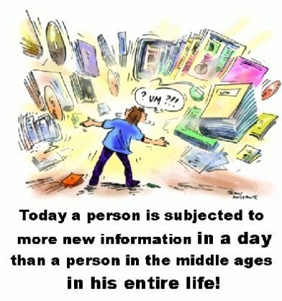
Trainings for users
Searching strategy
E-resource discovery Database searching
Information source criticism
Academic reading and writing
Reference manager EndNote, Mendeley Zetero etc.
Copyright, Plagiarism

Slide 19
Practical barriers
Barriers | Solutions
Organizational barriers
Budget limitations | Proper allocation of budget
Time constraint | In-house training, recruitment of efficient staff, Exclusive training department
Limited Infrastructure | Increasing the number of access point, databases, and also service points; Introducing online IL services
Requirement of training | Need base training program, increase facilities to practice after training

Slide 20
Practical barriers (Contd.)
Barriers | Solutions
Non-professional and inexperienced staff | Recruiting professional and experienced staff, train inexperienced staffs
Interpersonal Relationship | Need to encourage working together for sharing competence
Personal barriers
Attitude to learn | Motivate staffs to learn new things and take challenges
Anxiety to learn | Continuous monitoring and pushing staffs specially non-interested one to use the technology

Slide 21
Practical barriers (Contd.)
Barriers | Solutions
Technological barriers
Old devices | Updated hardware and software
Multi step access to database | Make the search interfaces among different databases easier, users friendly
Rapid changes of technology | Keep pace with technological development and also looks for alternatives

Slide 22
Best practices of online Information Literacy
Organization | Information literacy module link
National University of Ireland Galway, Trinity College Dublin & University College Cork collaboration | http://www.informationliteracy.ie/
Muskegon Community College, MI, USA | http://www.muskegoncc.edu/library/information-literacy-modules/
HEA SIF Project , Ireland | http://info-lit.shrivenham.cranfield.ac.uk/index.html
Norway –Denmark collaboration | http://www.phdontrack.net/

Slide 23
Considering factors for evaluating IL modules
Module type
Learning module
Training module
Teaching module Target users group
Students
Researchers
Trainers
General users
Module Structure
Interactivity
Efficient Navigation
User friendly Interface
Web pages design
Font, size, color
Fluidity in Architecture
Internal and external links

Slide 24
Considering factors for evaluating IL modules
Contents
Overview of IL
Key components units
Content organization
Easy to read text
Contents format
Text, Image
Audiovisual material etc
Self-reflection tutorials
Blogging & Social network
Others
Software/platform used
Users guide
Availability in document

Slide 25
Social aspects of Information literacy:
learning process, experience, users needs, training, and barriers of library professionals

